Slide 1
PPE-Training Staff and Competency Evaluation

Slide 2
Objectives
By the end of this session, participants will be able to:
  List 2 reasons why training staff on use of PPE is important for infection control.
  Describe 2 ways that training can be conducted on use of PPE.
  Explain how to perform competency evaluation of staff use of PPE.

Slide 3
Key Educational Takeaways
Proper use of PPE protects the healthcare worker from germs and prevents the transmission of germs to residents’
Facilities are required by OSHA and CMS to train healthcare workers on correct use of PPE.
Various training methods can be used to train staff on use of PPE but training that involves active learning is best (demonstration, practice).
Competency evaluation is needed to ensure healthcare workers correctly perform donning, doffing and use of PPE to ensure quality and safe resident care

Slide 4
OSHA Standard 1910.132 Requirements
The employer shall provide training to each employee who is required by this section to use PPE. Each such employee shall be trained to know at least the following:
  When PPE is necessary;
  What PPE is necessary;
  How to properly don, doff, adjust, and wear PPE;
  The limitations of the PPE; and,
  The proper care, maintenance, useful life and disposal of the PPE.
Each affected employee shall demonstrate an understanding of the training and the ability to use PPE properly, before being allowed to perform work requiring the use of PPE.
  Competency testing

Slide 5
OSHA Standard
When the employer has reason to believe that any affected employee who has already been trained does not have the understanding and skill required, the employer shall retrain each such employee. Circumstances where retraining is required include, but are not limited to, situations where:
  Changes in the workplace render previous training obsolete; or
  Changes in the types of PPE to be used render previous training obsolete; or
  Inadequacies in an affected employee's knowledge or use of assigned PPE indicate that the employee has not retained the requisite understanding or skill.

Slide 6
CMS F945 Training 483.95(e) Infection Control
A facility must include as part of its infection prevention and control program mandatory training that includes the written standards, policies, and procedures for the program as described at §483.80(a)(2).
  Standard and transmission-based precautions to be followed to prevent spread of infections

Slide 7
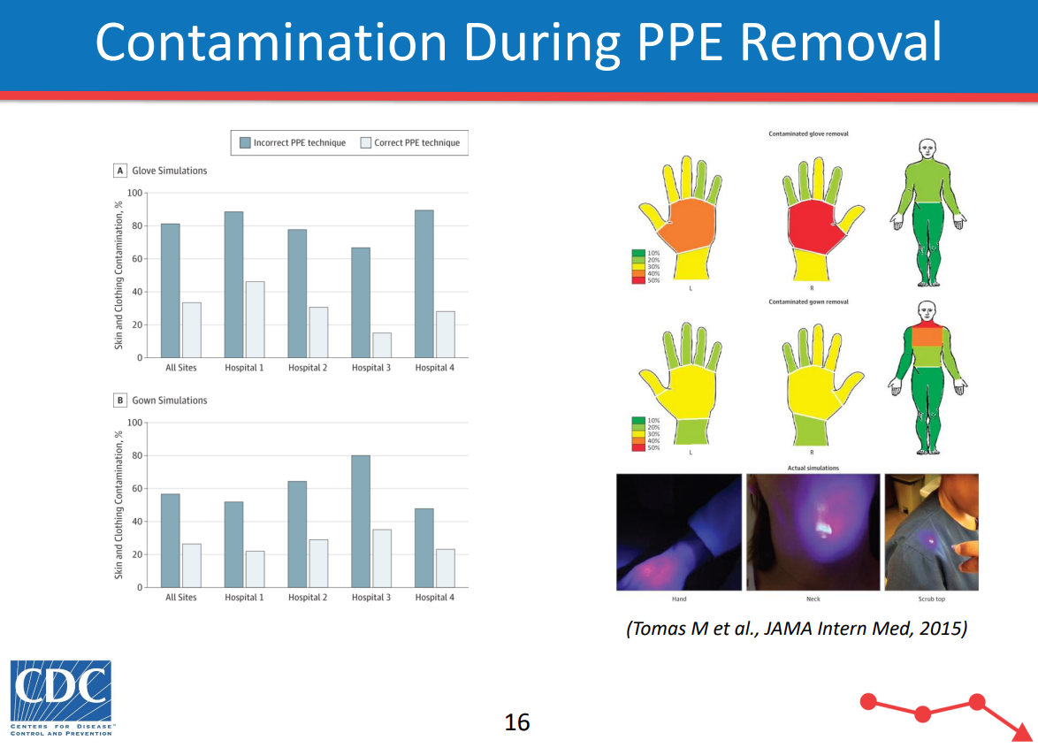
PPE Training
Goals of PPE use are to protect the healthcare worker from germs and prevent transmission of those germs
Limitations of PPE include:
  Correct fit
  Wearing incorrect PPE in clinical situations (i.e.; wearing face mask during aerosolization procedure on COVID-19 resident)
  Contamination from improper PPE removal
Notes:
Contamination from improper don/doffing was 79.2% in one study. (Kang 2017)

Slide 8
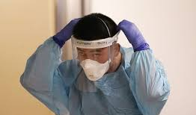
Barriers Identified by Healthcare Workers (Kang, 2017)
Time consuming
Cumbersome
Lack of training
Unsure of PPE effectiveness
Ecological concerns
Space (clean/contaminated)
Notes:
Ecological concerns with disposal of so much material
Space to store PPE, change out of PPE, access timely manner

Slide 9
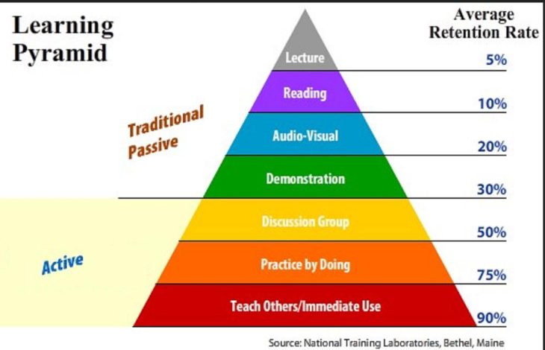
Developing Training
Training assessment can assist in determining the training needs and to prioritize them
  Which employees need PPE training
  What training do they need
  Who needs it the quickest
Determine methods to provide the training:
  Just-in-time, On-the-job
  Accessible information when needed (i.e.; infographics on donning/doffing PPE)
  Mobile training – carts, iPad for video viewing

Slide 10
PPE Training
Practice makes perfect – demonstration and return demonstration
  Don PPE correctly and in the correct order
  Remove and dispose of PPE correctly and without contamination
  Hand hygiene before donning and after removing PPE
  Simulate contamination using fluorescent glow solution, chocolate syrup, etc.
Training is not a one-time occurrence.
  Annual reviews
  Based on audits of staff performance
  Individual staff member performance

Slide 11
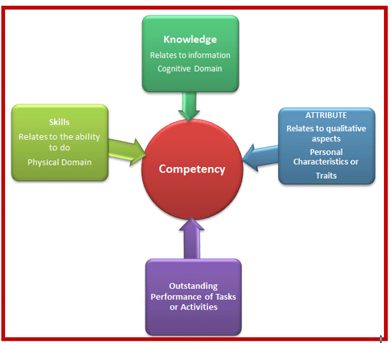
Competency Evaluation
Competency is the application of knowledge and skill in performance.
Assessing competency requires facility validation
  Defined process for all
  Determine if an individual can perform a task
  In a way that is consistent with the education and training provided.
  Assessed by qualified reviewers
Competency is NOT assessed via an education module with a post-test.
  An education module with just a post-test measures knowledge, not competence or proficiency.
Notes:
Competency evaluation ensures healthcare workers provide safe, quality care. It means that the worker demonstrates the knowledge of what to do, the skills and abilities to do it correctly, and the attitude that it needs to be done. So often people give an education module with a test and assume competency. One may be very knowledgeable about a skill, but unable to perform that skill safely. This is why demonstration of the skill is essential.
You validate competence by having a consistent and defined process, assessing their knowledge and skills of the process to be sure it is aligned with that defined process.
Staff with the educational background, experience, or knowledge related to the skills being reviewed will assess competence.

Slide 12
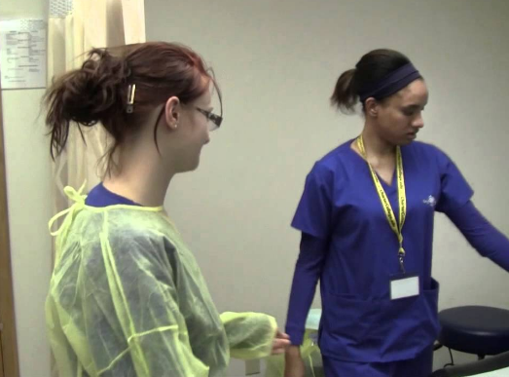
Competency Evaluation
Competency is best assessed via return demonstration and observation.
Additional methods include, but are not limited to:
  simulation,
  role playing
  case studies
  observations during resident care

Slide 13
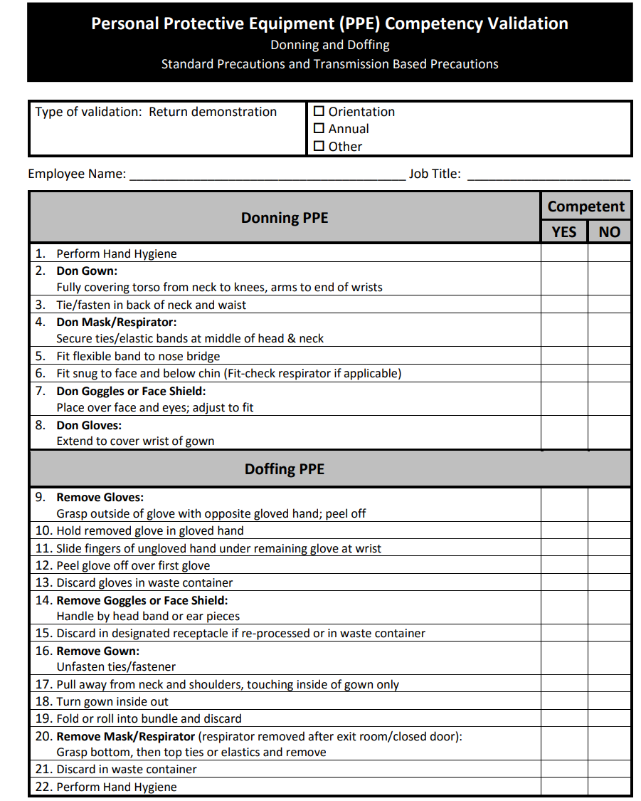
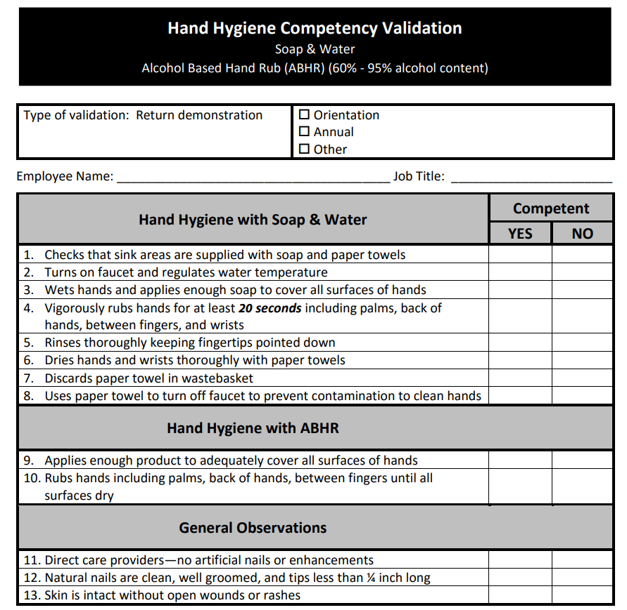
Competency Evaluation Examples

Slide 14
Breakout Discussion
Given the list of barriers, how could you address those issues with your fellow staff?
What part of determining competence (knowledge, skills, attributes) do you find hardest to assess and/or change?
What processes do you use to facilitate the competency testing of healthcare workers in various skills?
Notes:
Reminder Barriers are : Time consuming, Cumbersome, Lack of training, Unsure of PPE effectiveness, Ecological concerns
Space (clean/contaminated)

Slide 15
References
Bleich, Corey, edgepoint learning, “How To Roll Out PPE Training To Your Employees”
CardinalHealth, “The importance of staff training for proper PPE use”, March 22, 2022
CDC, Personal Protective Equipment Course WB 4225:
  PPE 103: “Training Frontline Health Care Professionals and Auditing Practices”,
  PPE 104: “Auditing and Feedback of PPE Use”
CMS State Operations Manual Appendix PP - Guidance to Surveyors for Long Term Care Facilities
Kang J, O’Donnell JM, Colaianne B, Bircher N, Ren D, and Smith KJ. Use of personal protective equipment among health care personnel: results of clinical observations and simulations. Am J Infect Control 45(1):17-23.
NC SPICE, “Personal Protective Equipment (PPE) Competency Validation” and “Hand Hygiene Competency Validation”
OSHA Standard 1920.132 General Requirements
Wound Reference, “Quality of Care Requires Ongoing Competency Evaluations”, February 14, 2022

